Slide 1
Interacting with Visualizations

Slide 2
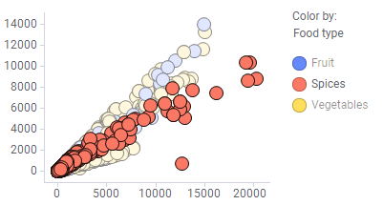
Marking

Slide 3
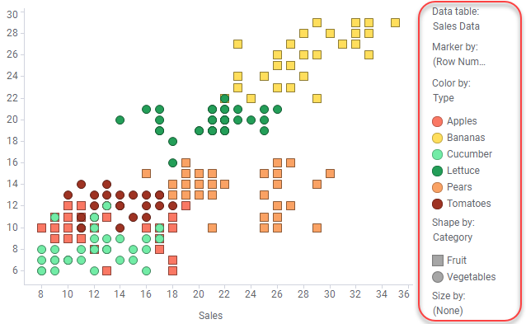
Columns and Legends

Slide 4
Multiple Data Tables
Category | Type | Sales 2017
Fruit | Apples | 19000
Fruit | Pears | 22000
Fruit | Bananas | 29000
Vegetables | Cucumber | 12000
Vegetables | Carrot | 25000
Vegetables | Lettuce | 19000
Category | Type | Sales 2018
Fruit | Apples | 25000
Fruit | Pears | 21000
Fruit | Bananas | 31000
Vegetables | Cucumber | 13000
Vegetables | Carrot | 20000
Vegetables | Lettuce | 17000
Comparing the data in the two data tables above in a bar chart does not require any special adjustments. Just load the two data tables into Spotfire, create the bar chart, select one of the categorical columns on the category axis, and then select the two columns 'Sales 2017' and 'Sales 2018' on the value axis.

Slide 5
Multiple Data Tables – Levels of Detail
Category | Type | Target
Fruit | Apples | 25000
Fruit | Pears | 21000
Fruit | Bananas | 31000
Vegetables | Cucumber | 13000
Vegetables | Carrot | 20000
Vegetables | Lettuce | 17000
Transaction | Category | Type | Sales
FA-001 | Fruit | Apples | 1840
FA-002 | Fruit | Pears | 2300
FA-003 | Fruit | Bananas | 4560
FA-004 | Vegetables | Cucumber | 1875
FA-005 | Vegetables | Carrot | 5425
FA-006 | Vegetables | Lettuce | 1245
FA-007 | Vegetables | Cucumber | 6548
FA-008 | Fruit | Apples | 4123
FA-009 | Fruit | Bananas | 1234
FA-010 | Vegetables | Carrot | 1111

Slide 6
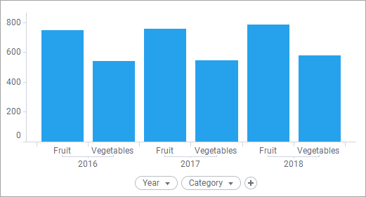
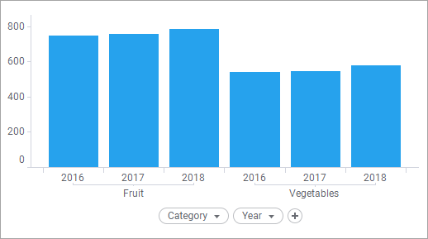
Hierarchies

Slide 7
Exercise
You will use the flight delay data (flight-delays-1to14.csv and flight-delays-15to30.csv) in the course repository.
Create a bar chart comparing side by side the departure delay on Jan 1-14 and Jan 15-30.
Now create a new table combining the full information of these two files (all the rows).
Create a visualization showing the average delay (arrival + departure) per carrier.

